Slide 1
Pima dataset
Sajith k v

Slide 2
DATA EXPLORATION
Read PIMA diabetes Dataset
Read First set of data
Read Tail set of data
Describe the dataset

Slide 3
DATA EXPLORATION
# collect the data.
import pandas as pd
import matplotlib.pyplot as plt
df=pd.read_csv('C:\Sajith\Assignments 2\diabetes.csv')
print(df)
df.head()
df.tail()
df.describe()

Slide 4
DATA VISUALISATION
SCATTER PLOT
import matplotlib.pyplot as plt
import pandas
from pandas.plotting import scatter_matrix
url = " 'C:\Sajith\Assignments 2\ diabetes.data.csv"
names = ['preg', 'plas', 'pres', 'skin', 'test', 'mass', 'pedi', 'age', 'class']
data = pandas.read_csv(url, names=names)
scatter_matrix(data)
plt.show() sns.pairplot(df[cols], size=2.5);
plt.show()

Slide 5
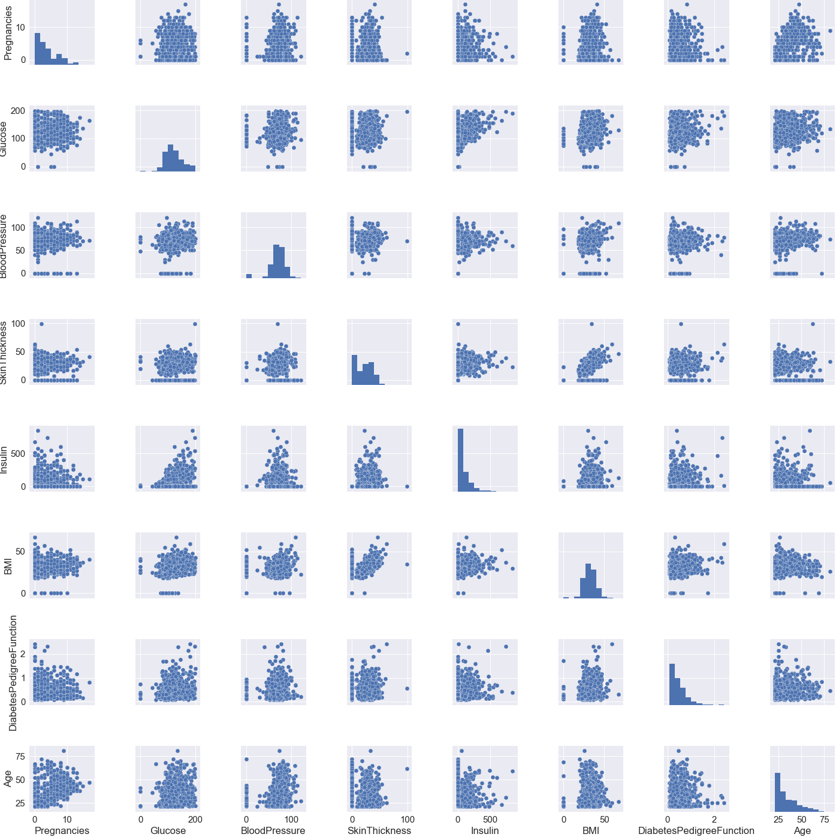

Slide 6
HISTOGRAM
df.hist(figsize=(12,8),bins=20)
3 BOXPLOT
A = df['Age']
plt.boxplot(A)
plt.show()

Slide 7
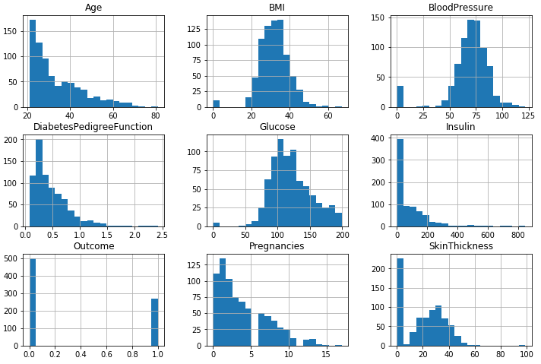
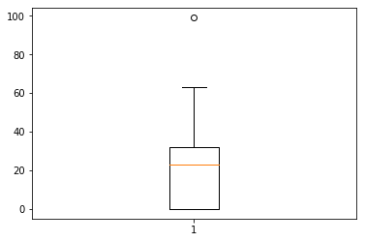
BoxPlot
Histogram

Slide 8
ACCURACY PREDICTION
Find out accuracy prediction using Nearest neighbour Algorithm
Divide dataset into Traindata and Testdata
Find out the minimum minimum distance between Testdata with all Traindata using NN
3 Find prediction accuracy

Slide 9
1 Divide dataset into Traindata and Testdata
import csv as csv
import math
import operator
f=open("C:/Sajith/assignment_2/diabetes.csv","r")
reader=csv.reader(f,delimiter=',')
next(reader)
c=-1
correct=0
traindata1=[]
testdata1=[]
traindata=[]
testdata=[]
for i in reader:
c=c+1
if(c<538):
traindata1.append(i)
else:
testdata.append(i)
traindata.extend(traindata1)
testdata.extend(testdata1)
index=0
print("traindata\n")
for x in traindata:
print(x)
print("%%%%%%%%%%%%%%%%%%%%%%%%%%%%%%%%%%%%%%%%%%%%%%%%%%%%%%%%%%%%")
print("testdata\n")
for x in testdata:
print(x)

Slide 10
Find out the minimum minimum distance between Testdata with all Traindata using NN
Find prediction accuracy
for x in testdata:
min_dist=100.0
for y in traindata:
distances=0
for j in range(0,8):
m=float(y[j])
n=float(x[j])
distances=distances+math.pow((m-n),2)
if(distances<min_dist):
min_dist=distances
index=y[8]
if(x[8]==index):
if(x[8]=='1'):
predict=predict+1
print("Predict",predict)
print("prediction acccurcy")
print(predict*100/230)
Output
Predict 25
prediction acccurcy
10.869565217391305

